Slide 1
Smoke Detector Using Arduino and Labview
Developed By:
I031 Ashmit Lal
I046 Soham Patil
I071 Dhrumil Parekh
Under the Guidance of
Prof. Dattatray Sawant
Sem : VI Subject : OE- SCADA
B Tech AI
Academic Year : 2023 -2024

Slide 2
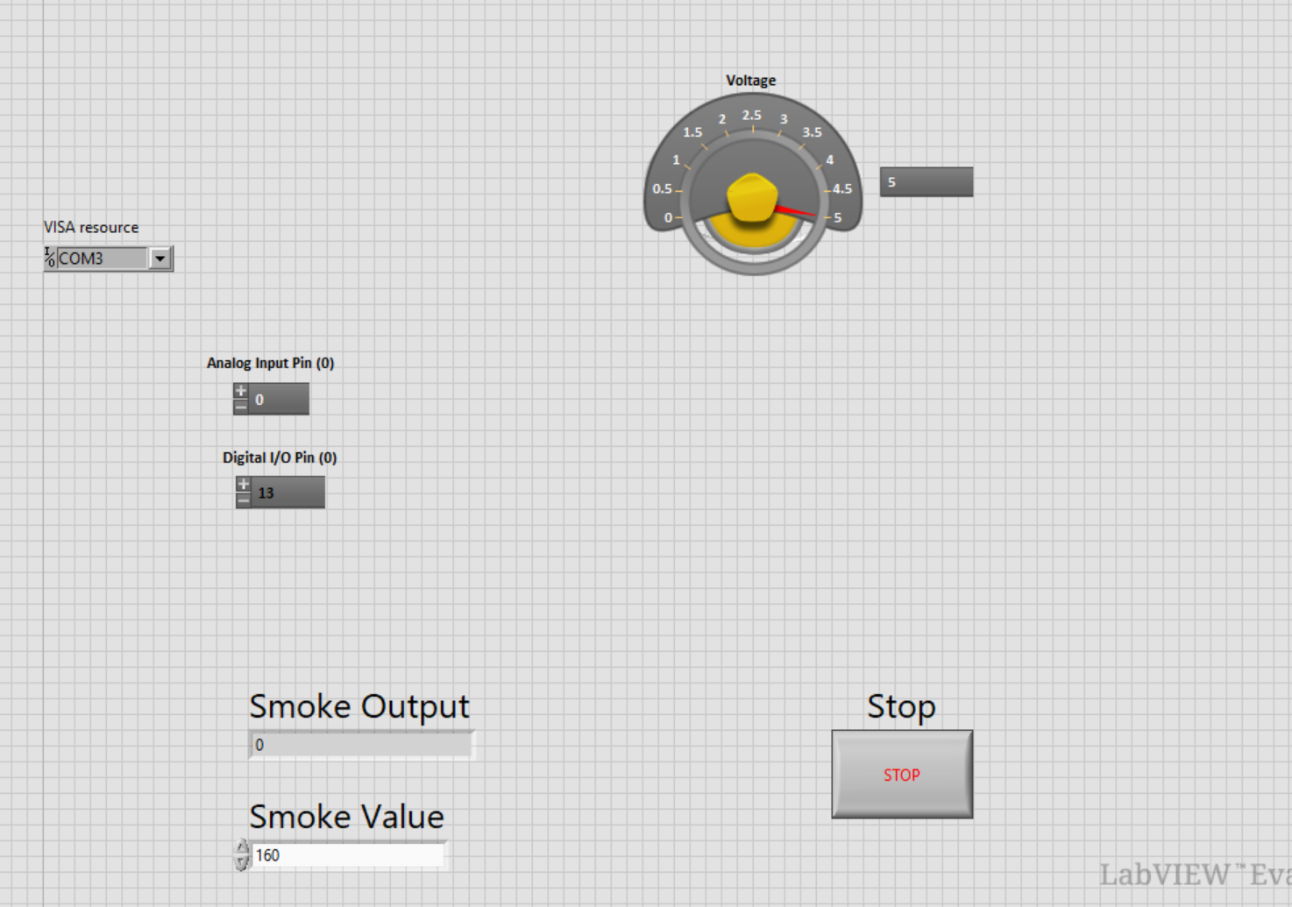
VI’s used in Front Panel

Slide 3
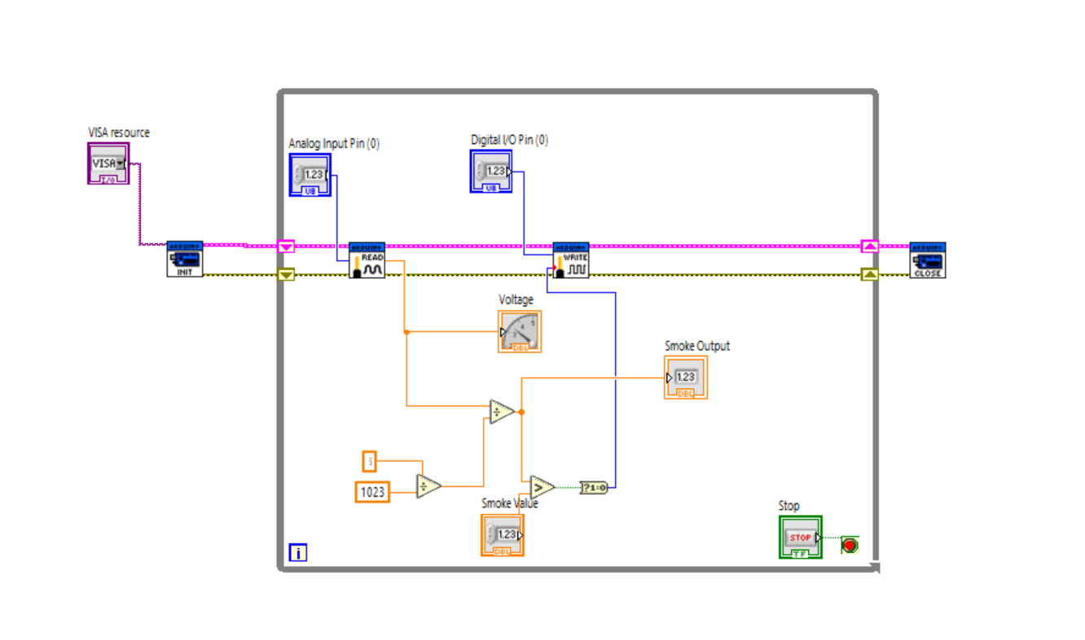
VI’s used in Block Diagram

Slide 4
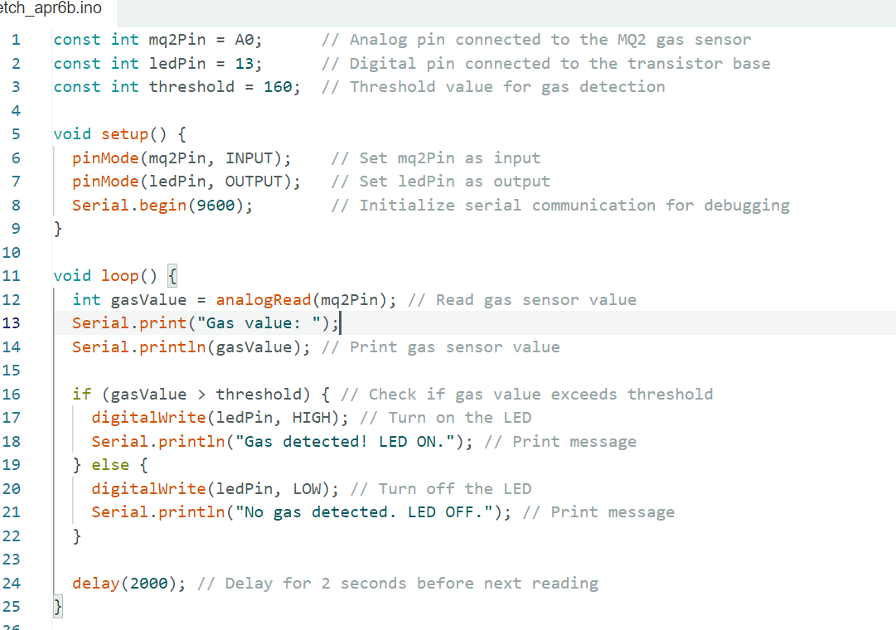
Arduino Code snippet

Slide 5
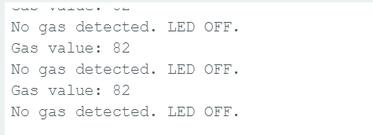
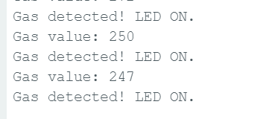
Arduino Outputs
No smoke
Smoke detected

Slide 6
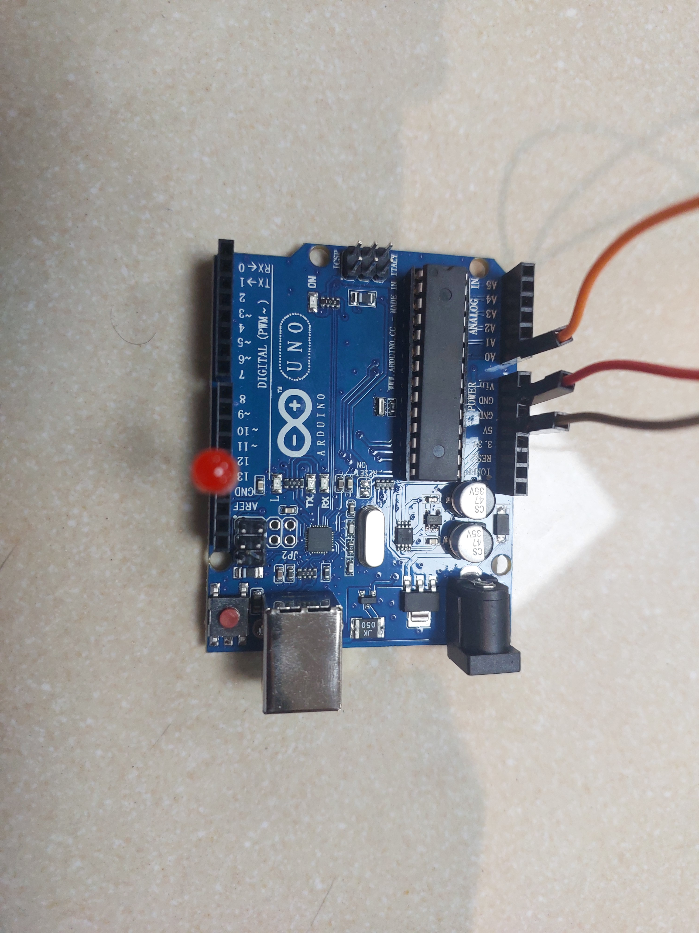
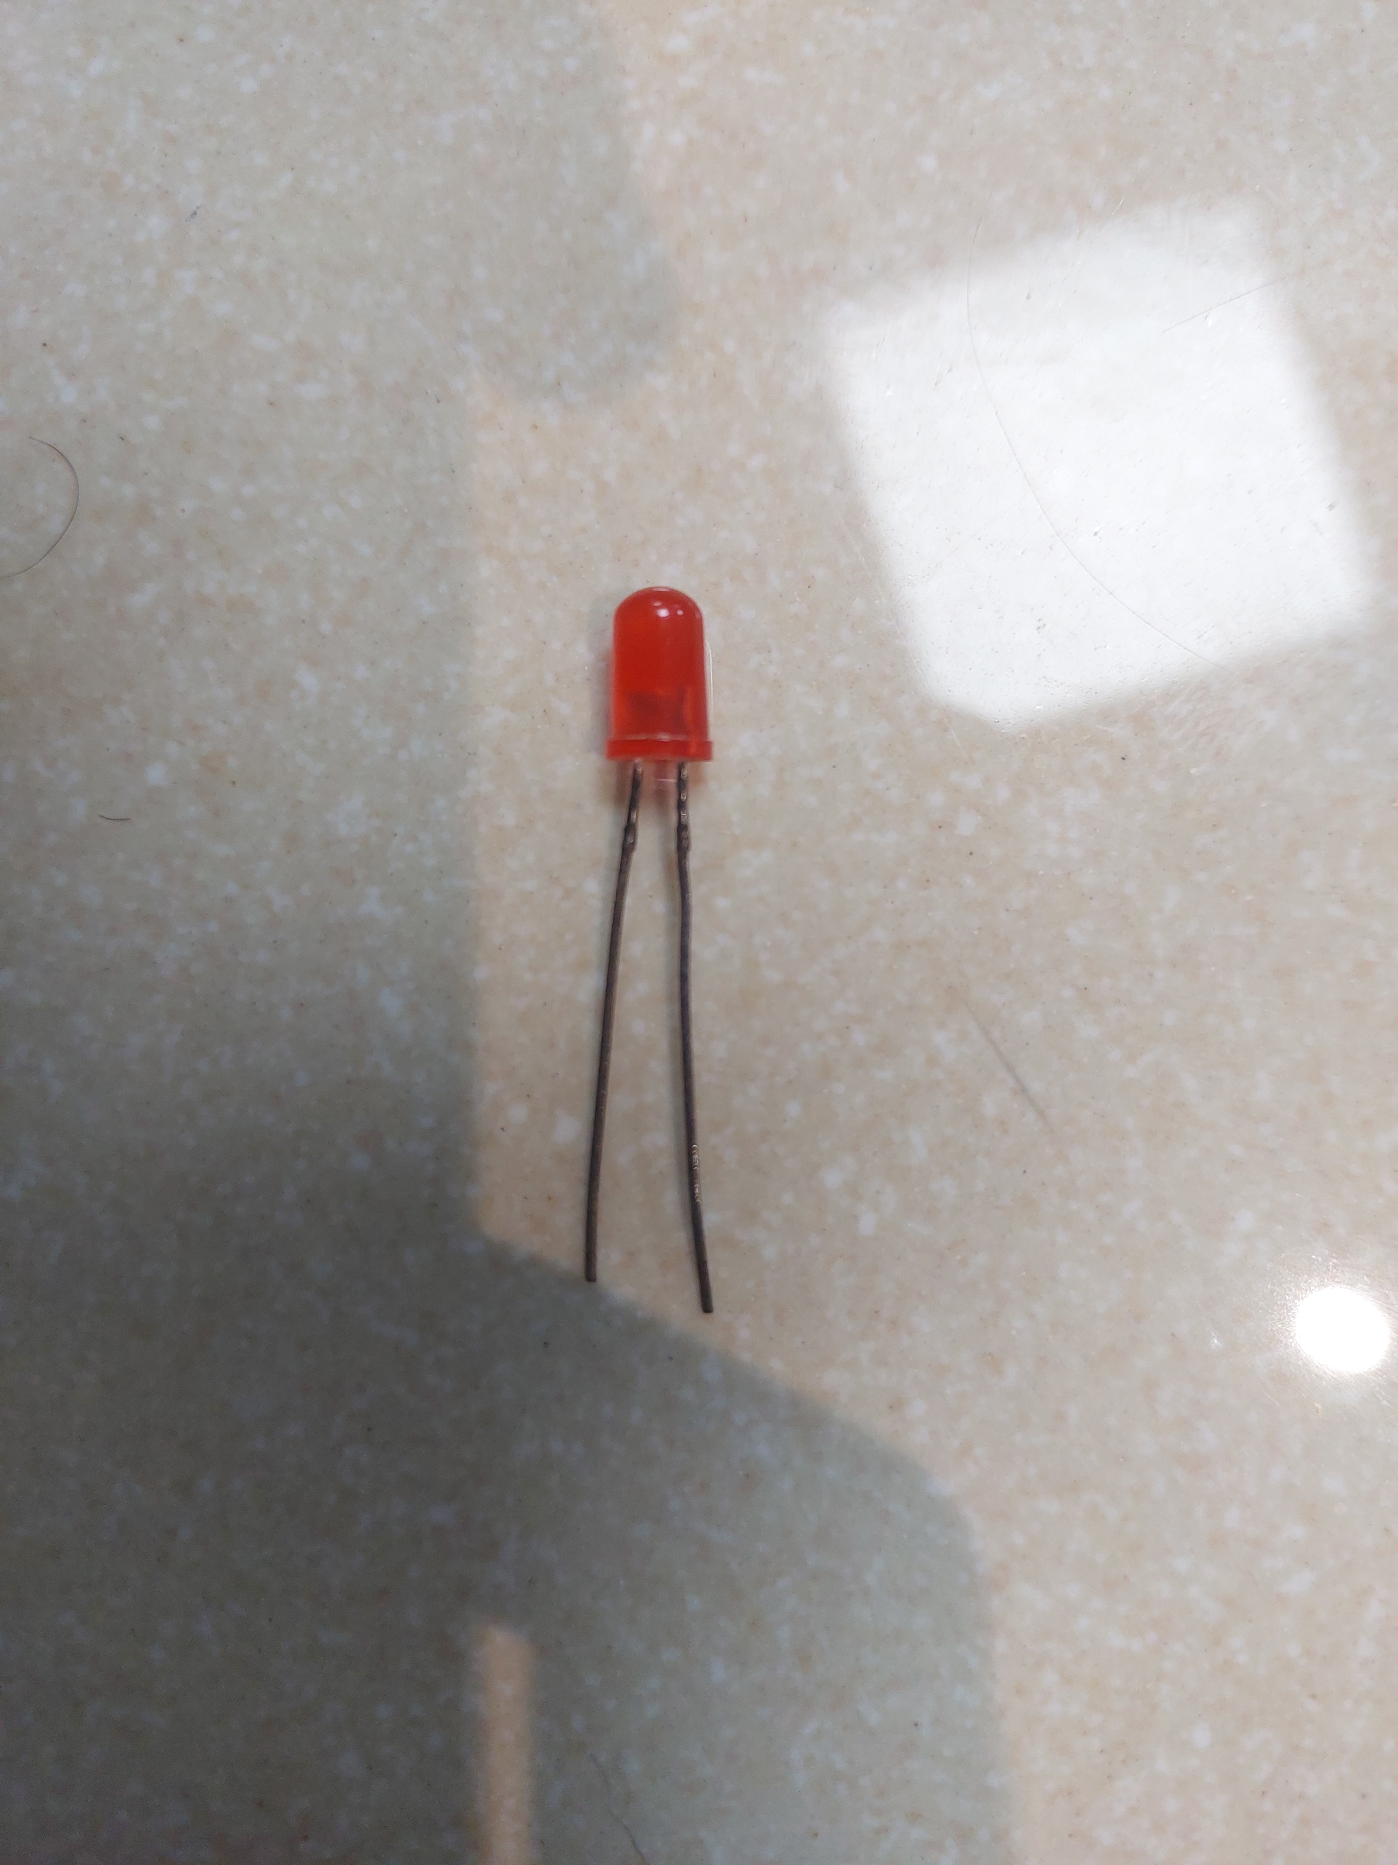
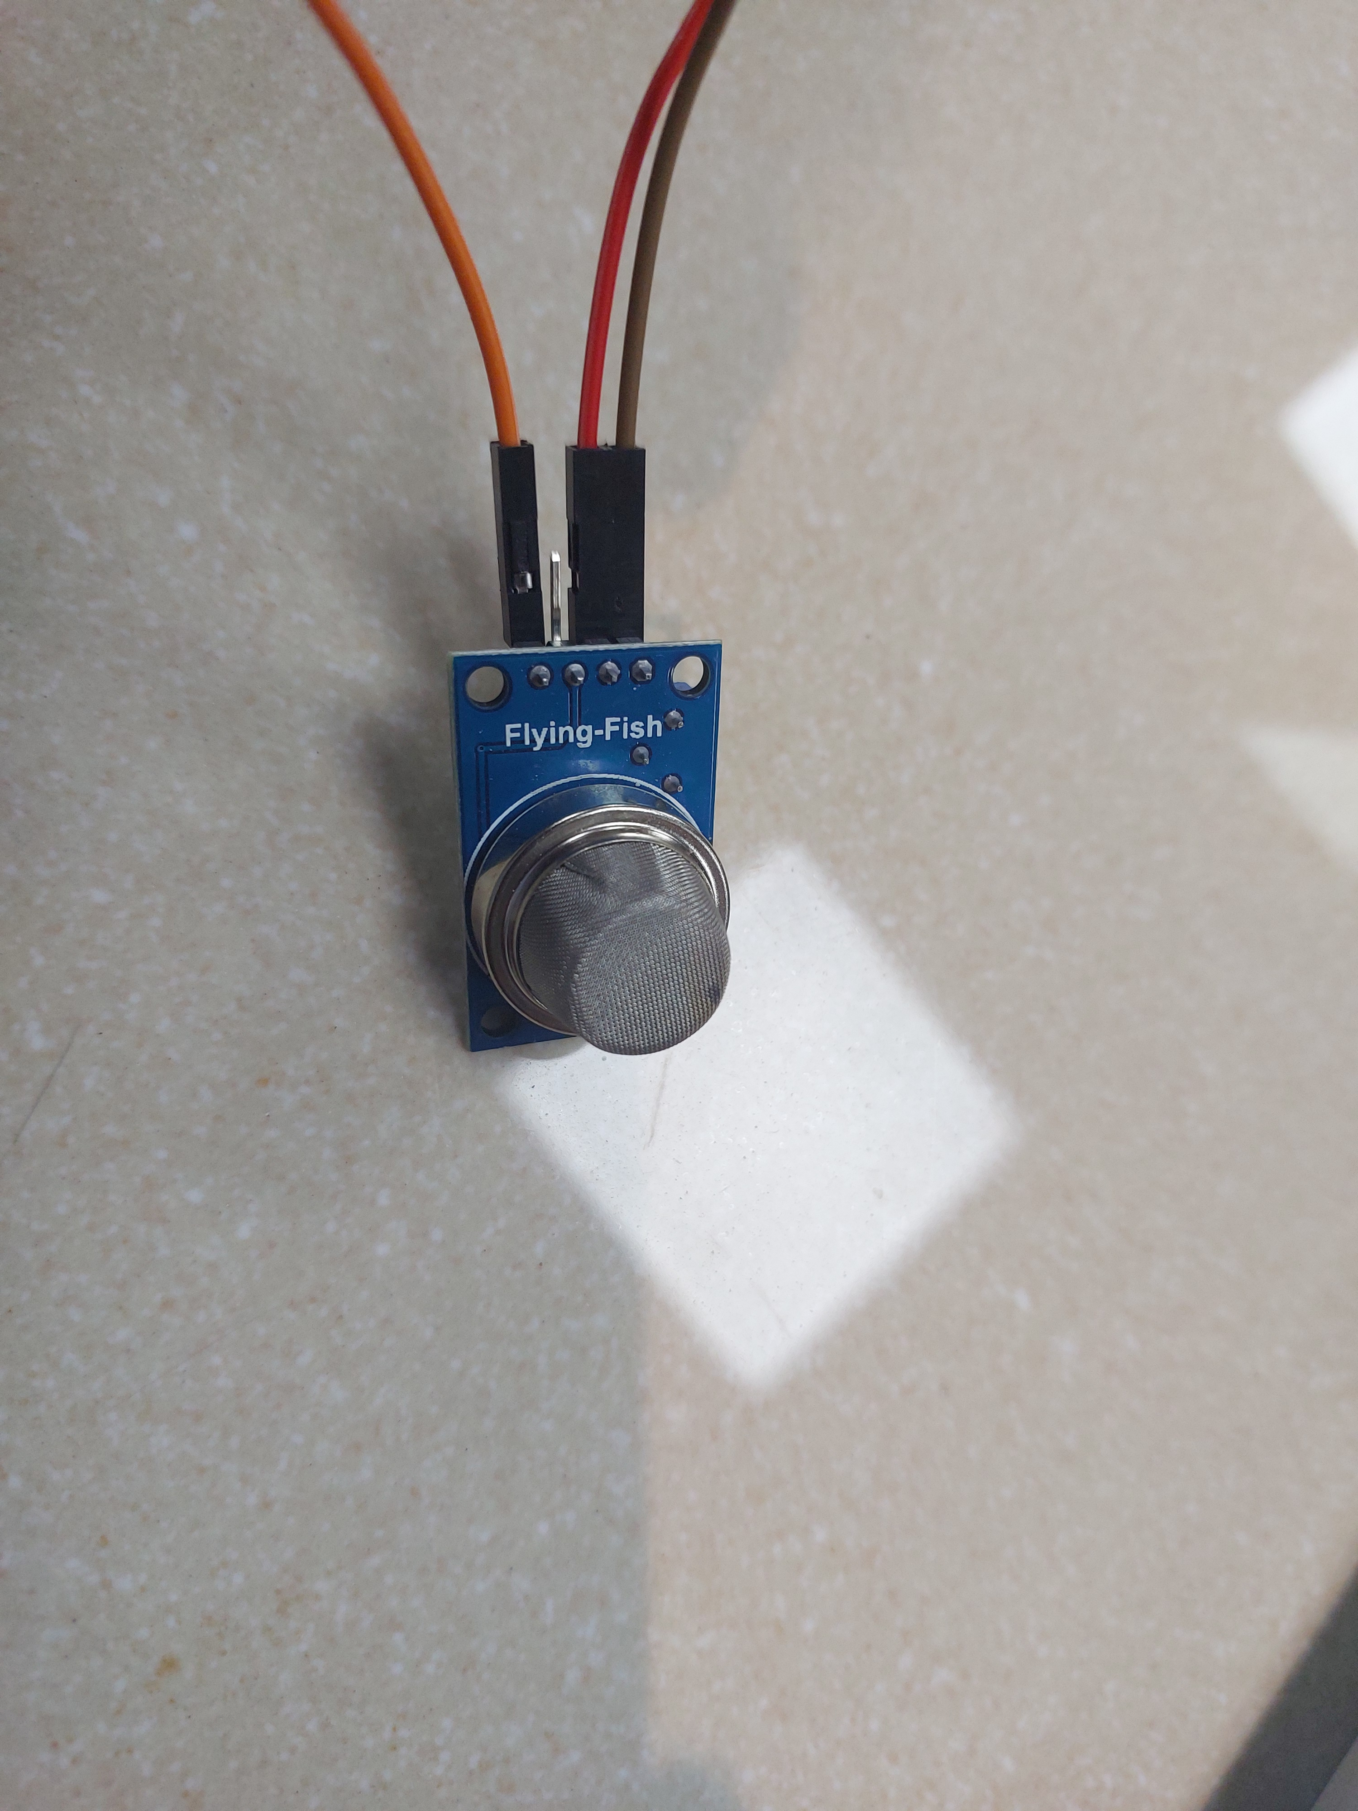
Components used in Hardware
Arduino Uno R3
MQ-2 Smoke Sensor
Uno Cable
LED

Slide 7
THANK YOU

